Slide 1
3D films quality estimation
Shevchenko Maksym, AI-2

Slide 2
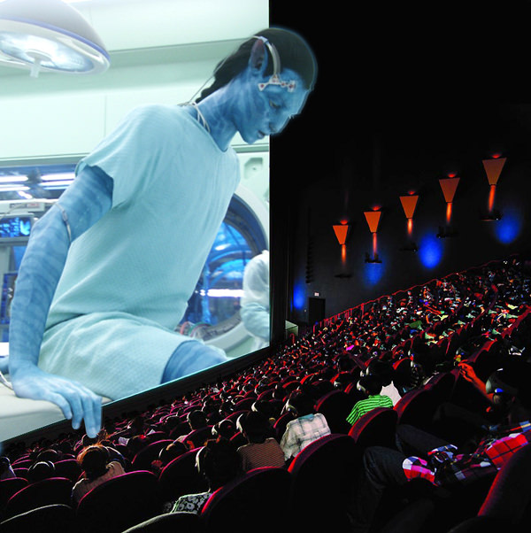
Introduction
Three-dimensional 3D films are motion pictures made to give an illusion of three-dimensional solidity, usually with the help of special glasses worn by viewers.
3DTV could provide sense of presence, however it has severe problem of causing visual fatigue by various reasons besides the compression impairment:
misalignment
color imbalance
asynchronization
etc.

Slide 3
Introduction
W.A.Ijsselsteijn, H.de Ridder, J.Vliegen, “Subjective Evaluation of Stereoscopic Images: Effects of Camera Parameters and Display Duration,” IEEE Transaction on CSVT, Vol.10, No.2 (2000)
“3DC Safety Guidelines for Popularization of Human-friendly 3D,” 3D Consortium (2006)
Y. Nojiri, H.Yamanoue, S.Ide, S.Yano, F.Okano, “Parallax Distribution and Visual Comfort on Stereoscopic HDTV,” IEIC Technical Report, Vol.102, No.224 (2002)

Slide 4
Quality metrics
Horizontal disparity
Vertical disparity
Scale mismatch
Rotation mismatch
Color mismatch
Sharpness mismatch
Stereo window violation
Crosstalk noticeability
Depth continuity
Cardboard effect
Edge-sharpness mismatch
Channel mismatch
Temporal asynchrony
Stuck-to-background objects
Classification by production type
Comparison with the 2D version
Perspective distortions
Converged axes

Slide 5
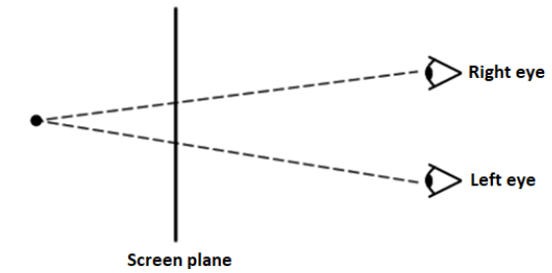
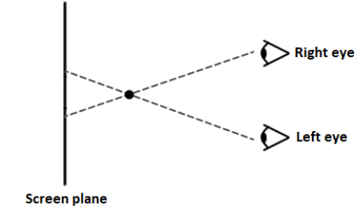
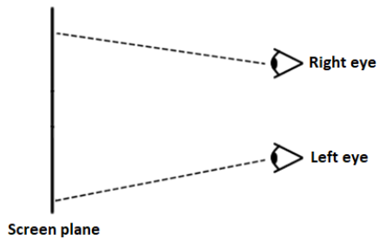
Horizontal disparity. Parallax range estimation
The parallax in 3D video is defined as the offset of a pixel in the right view relative to its position in the left view. Commonly denoted as a percentage of screen width.
Positive Negative More than infinity

Slide 6
Horizontal disparity. Parallax range estimation
A stereo matching algorithm is used to determine disparity between left and right views
A histogram of lengths of matching vectors is computed
The histogram is cut off at the ends to eliminate outliers

Slide 7
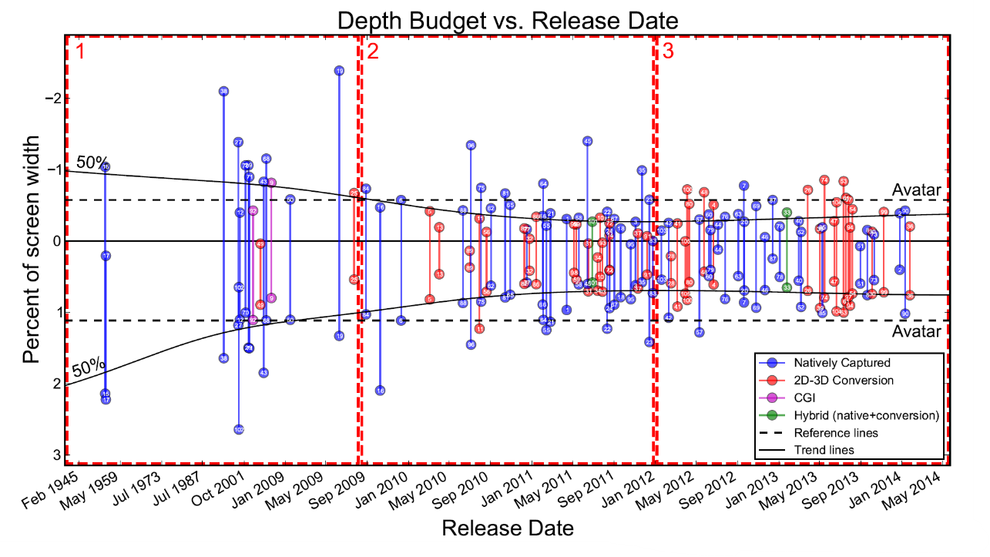

Slide 8
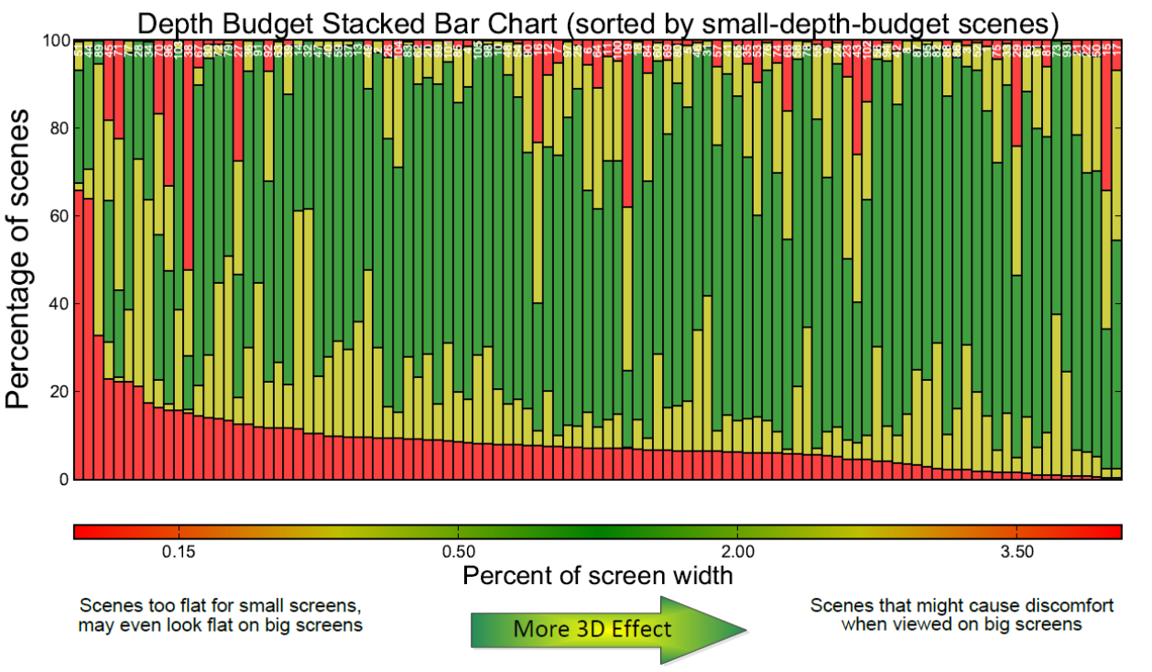

Slide 9
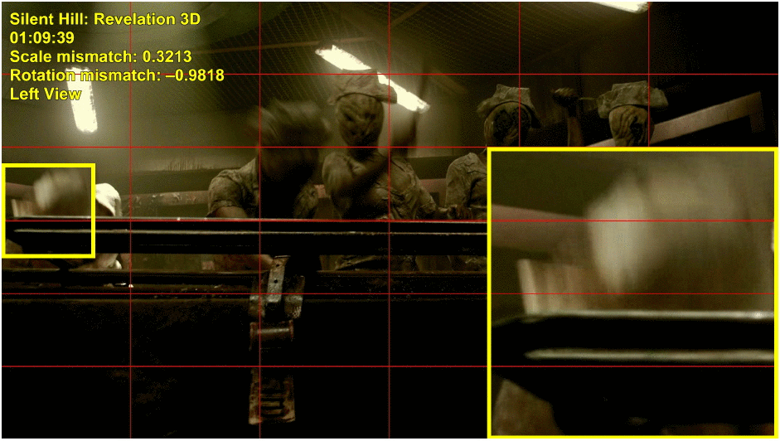
Geometric distortions analysis. Rotation mismatch

Slide 10
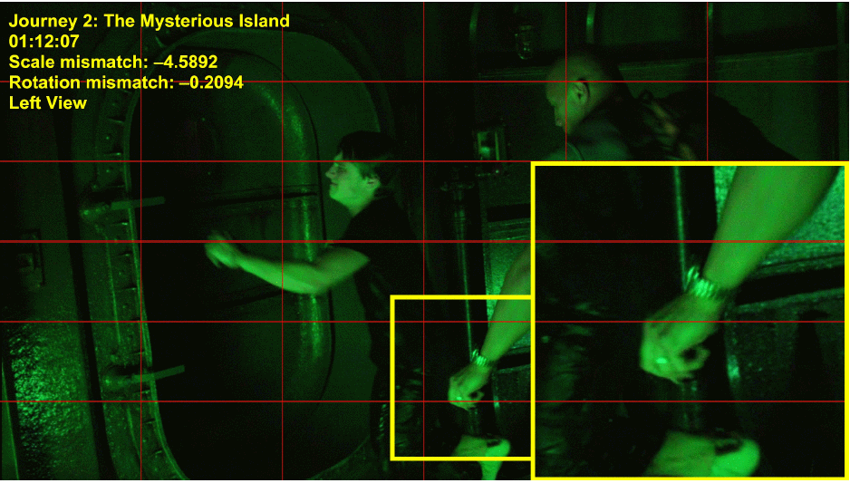
Geometric distortions analysis. Scale mismatch

Slide 11
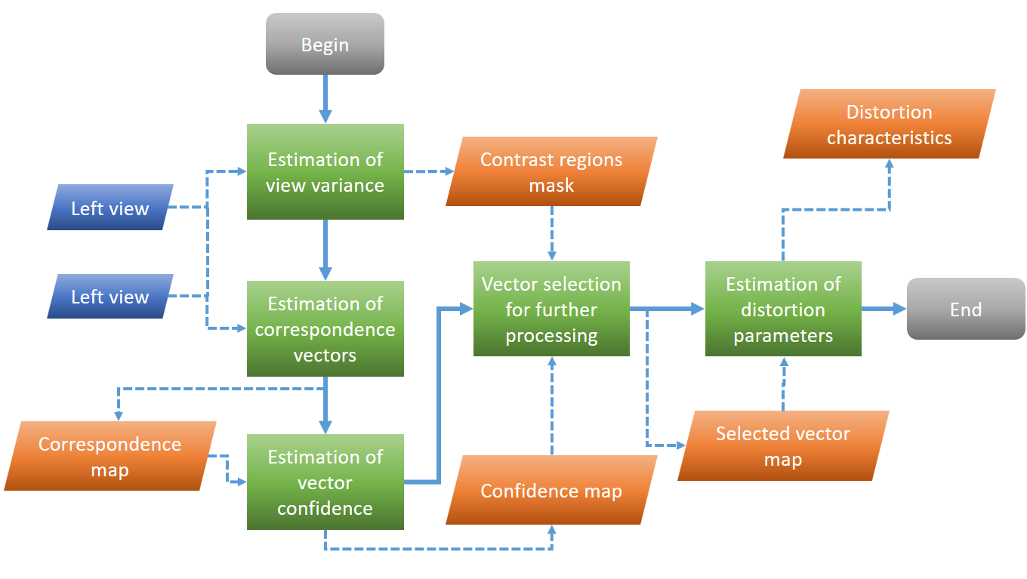
Rotation mismatch. Geometric distortions analysis
RANSAC
RANdom SAmple Consensus

Slide 12
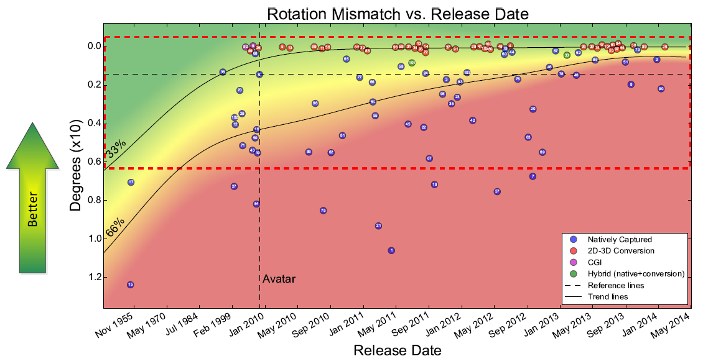

Slide 13
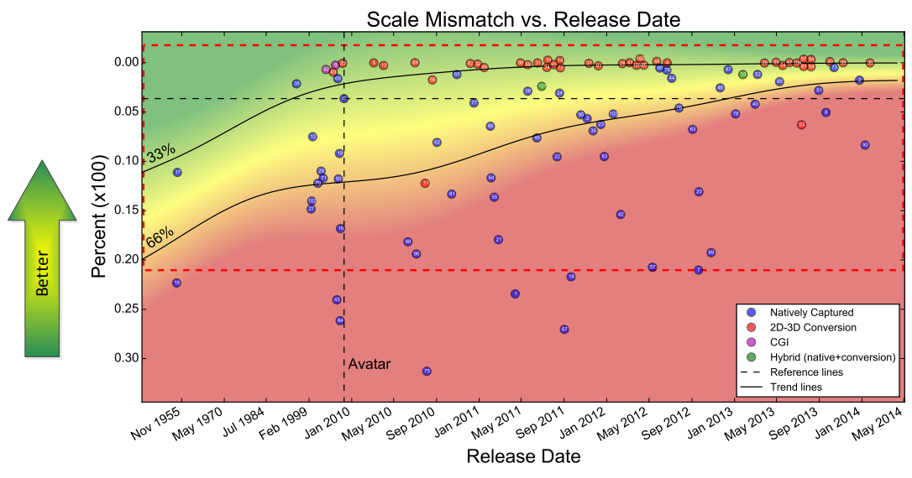

Slide 14
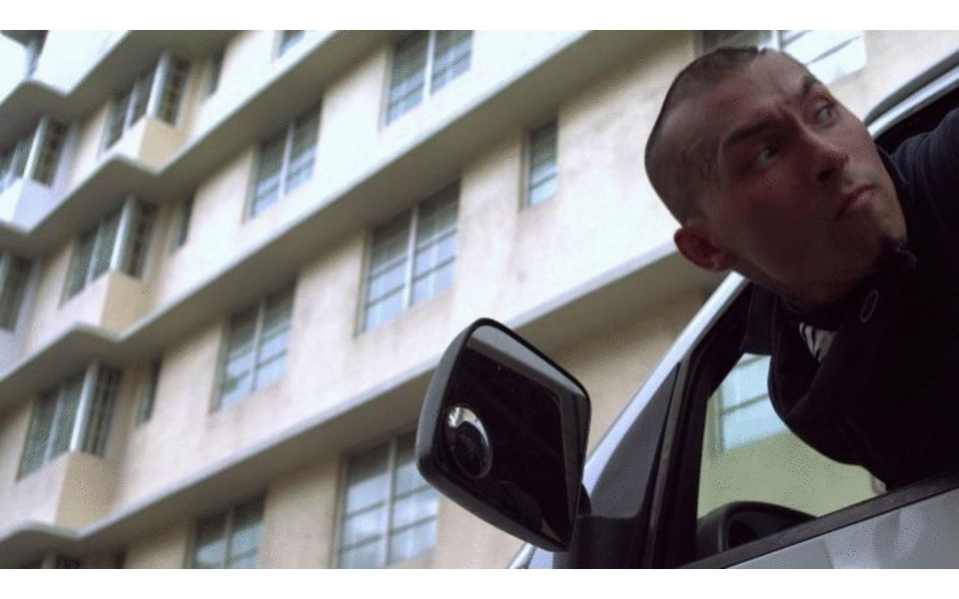
Color mismatch

Slide 15
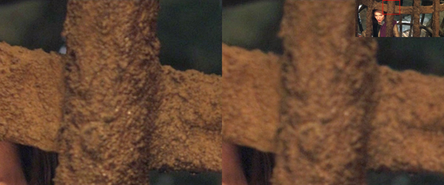
Sharpness mismatch

Slide 16
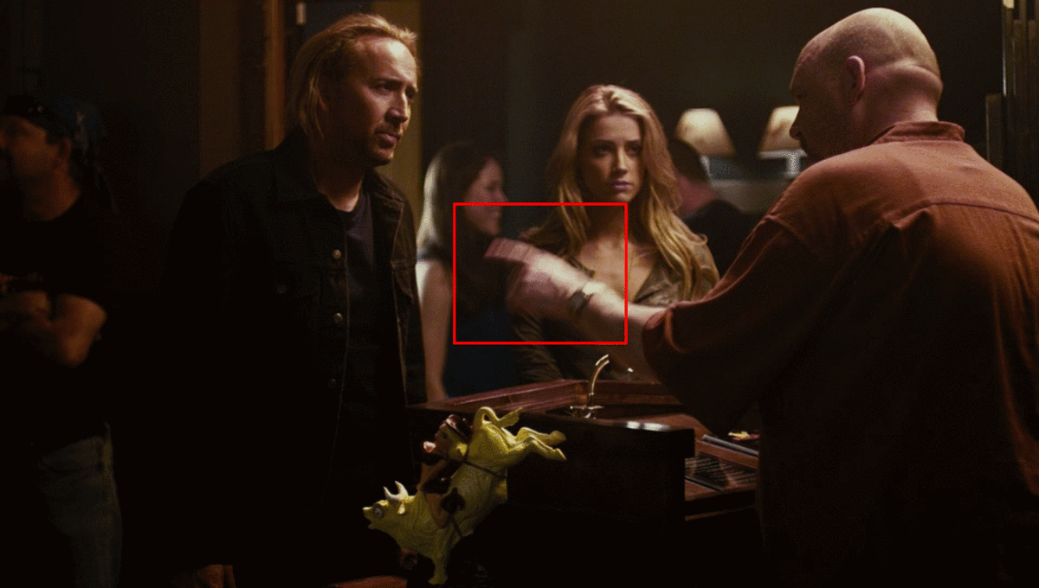
Temporal shift

Slide 17
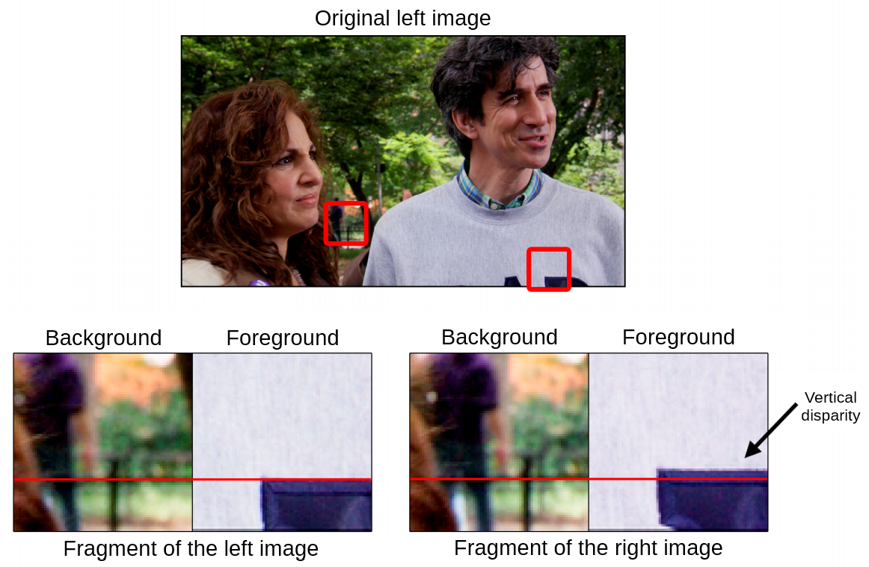
Perspective distortions

Slide 18
Thanks for your attention!

